Slide 1
Discussion Skills and Quality Questions
Peer Facilitator Workshop
Donna L. Pattison, PhD
Instructional Professor
Department of Biology & Biochemistry

Slide 2
What is it that a talk show host does to stimulate interesting discussions on radio or TV programs?

Slide 3
Metacognition
What is it? Write down what you think it means.

Slide 4
Metacognition
Thinking about how you think.

Slide 5
Wait Time
The new teacher asked a question expecting an excited barrage of answers and…
“I waited and waited. Anyone? Longer and longer. Help? It felt like an hour. A week. A year. Would the wait be worth it? A…yes? Finally from the back of the class!”
Allen, D. and Tanner, K. (2007) Transformations:
Approaches to College Science Teaching. W.H. Freeman Publishers, p. 19

Slide 6
Wait Time
Average wait time: 1.5 seconds
For perceived bright students: 2 seconds
For perceived less able students: 0.9 seconds
Results of waiting 3-5 seconds:
More complex answers
Increase in response length from 7 to 28 words
Less “I don’t know” answers
More students offering answers

Slide 7


Wait Time
Relax.
Tell the class “Think about that for a minute”.
Take a sip of water or coffee or tea to fill time.
Invite answers again, “Now that you’ve had time to think, anyone care to respond?”
No response. Ask leading questions to move the class to the answer without giving them the answer directly.

Slide 8

How do you encourage question asking? Answering?

Slide 9

How do you encourage question asking?
Ask “Are there are any questions?”
Comments like “I’m glad you asked that” or “Good question” or “great point”.
Enthusiasm.
Answering
Wait time.
Toss a ball into the classroom. Whoever catches it or it lands near answers. Student choses who to pass to.
Names in beaker.
Randomly call by name.
Pencil with eyes closed on clipboard with roster.
Warn students one person from group will be called on…

Slide 10

Artful Questions Don’t tell…ask!
What do you think would happen if…?
Where have you looked for the answer?
Have you considered X?
How would you determine this?
Can you explain to my why you chose x, y, or z here?
Trowbridge, L. and Bybee, R. (1990) Becoming a Secondary School Science Teacher.Merrill Publishers, Chapter 14.

Slide 11


Artful Questions Don’t tell…ask!
Think ahead.
Come to class prepared with a list of leading questions.
Be flexible.

Slide 12
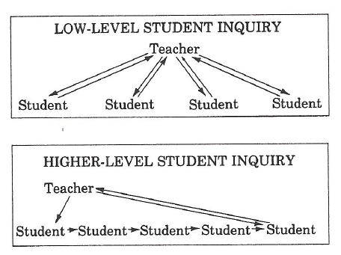
Trowbridge, L. and Bybee, R. (1990) Becoming a Secondary School Science Teacher.Merrill Publishers, Chapter 14.

Slide 13





Try to move away from Q & A sessions that look like this….

Slide 14
To Q & A sessions that look like this….

